Slide 1
Visual features representations
using convolutional neural networks

Slide 2
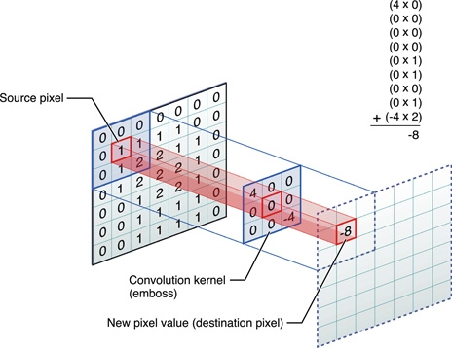
what is convolution ?

Slide 3
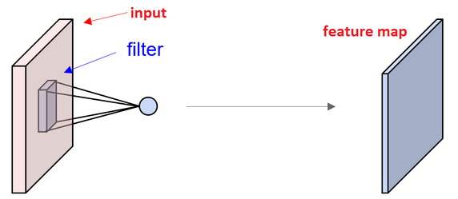
What is feature maps ?

Slide 4
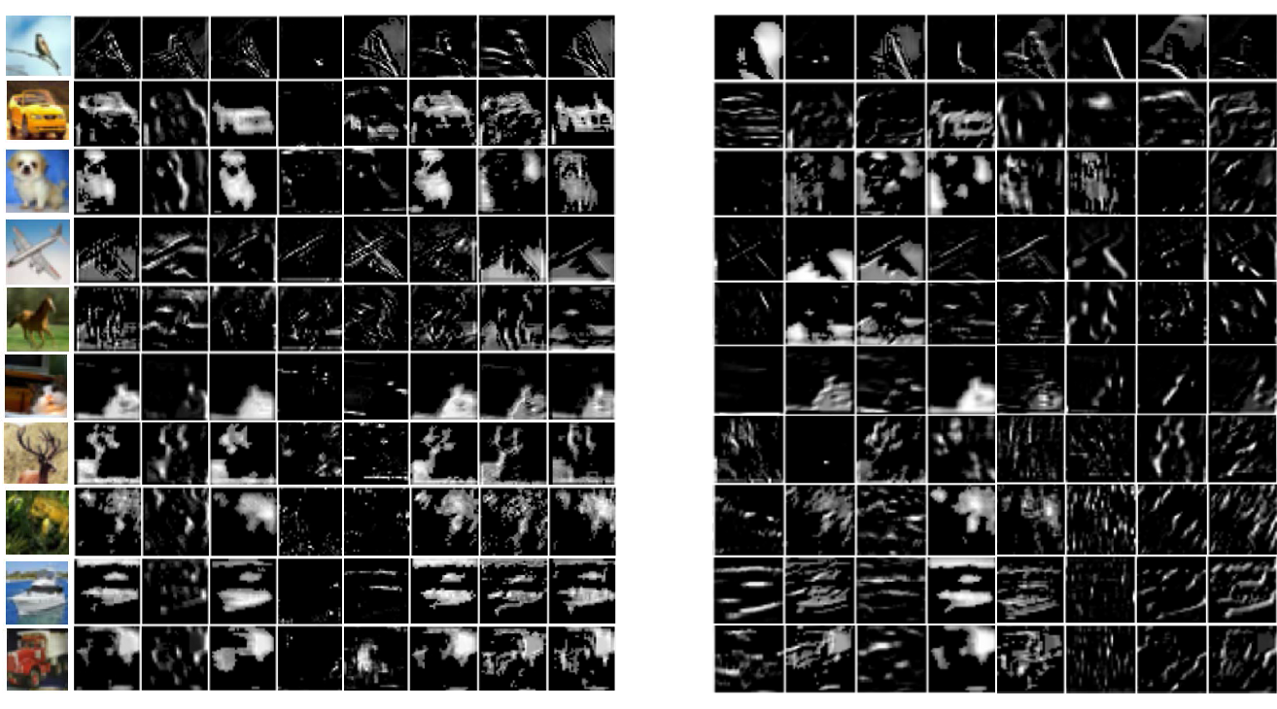
What is feature maps ?

Slide 5
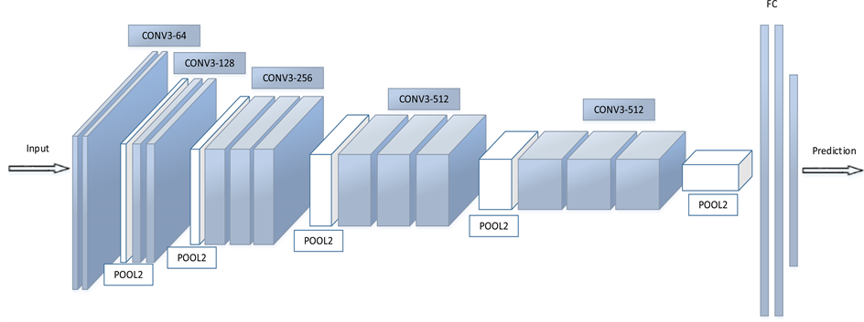
What is convolutional neural network?

Slide 6

What is max pooling ?

Slide 7
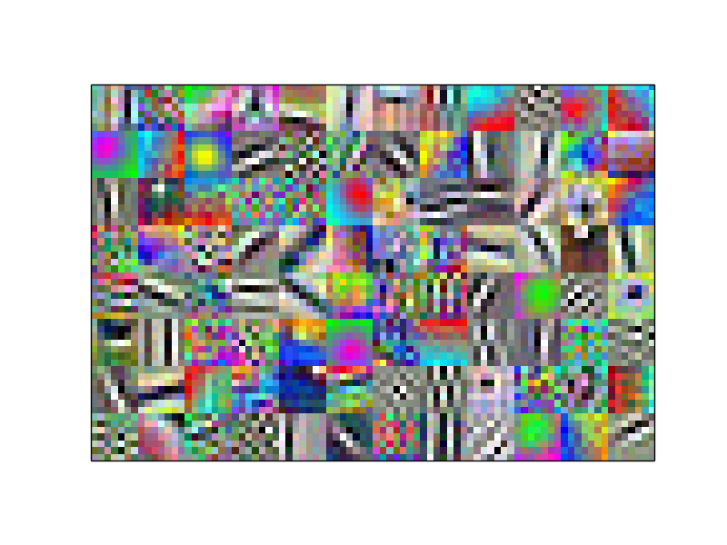
How do learned visual features look like ?
low level:

Slide 8
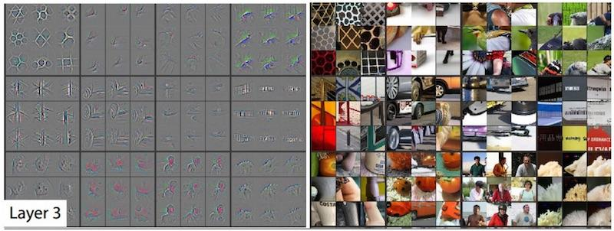
How do learned visual features look like ?
higher level:

Slide 9
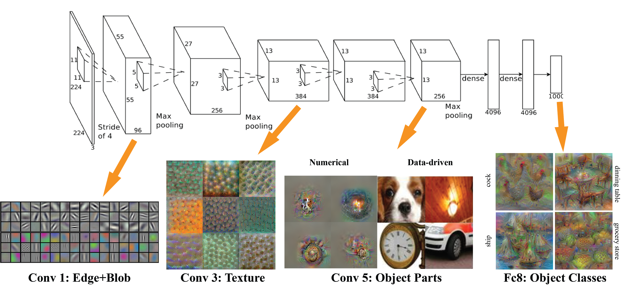
How do learned visual features look like ?

Slide 10
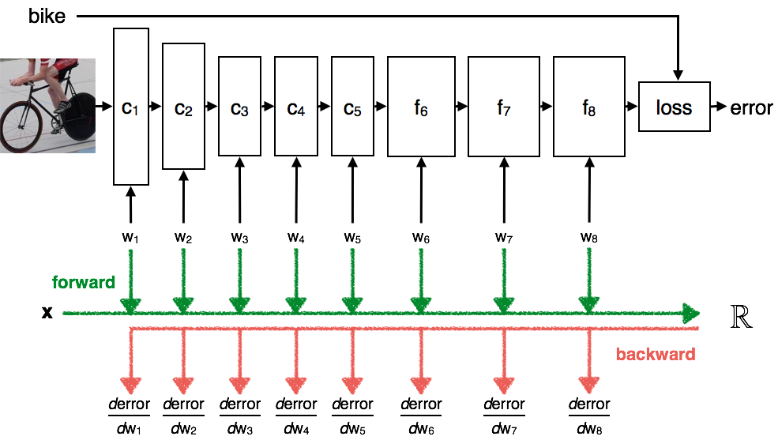
How it is trained ?

Slide 11
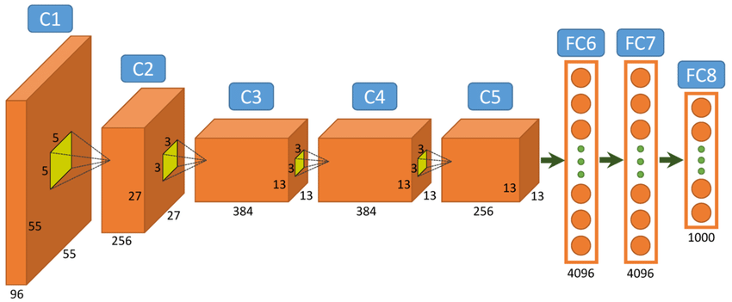
Evolution of CNN architecture:
AlexNet:

Slide 12
Evolution of CNN architecture:
VGG:

Slide 13
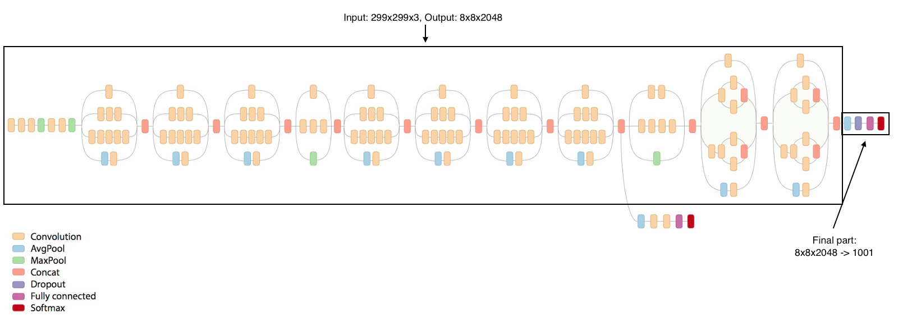
Evolution of CNN architecture:
Inception:

Slide 14
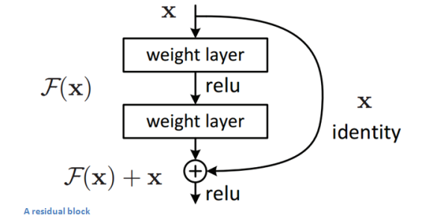
Evolution of CNN architecture:
ResNet:

Slide 15
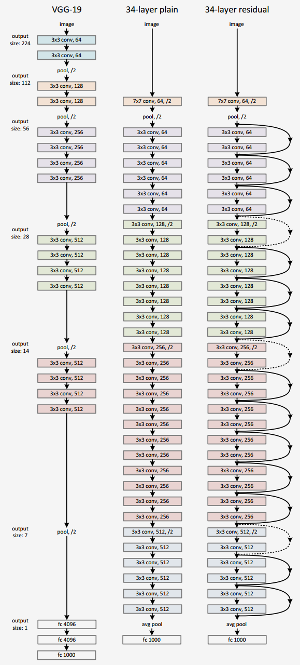
Evolution of CNN architecture:
ResNet:

Slide 16
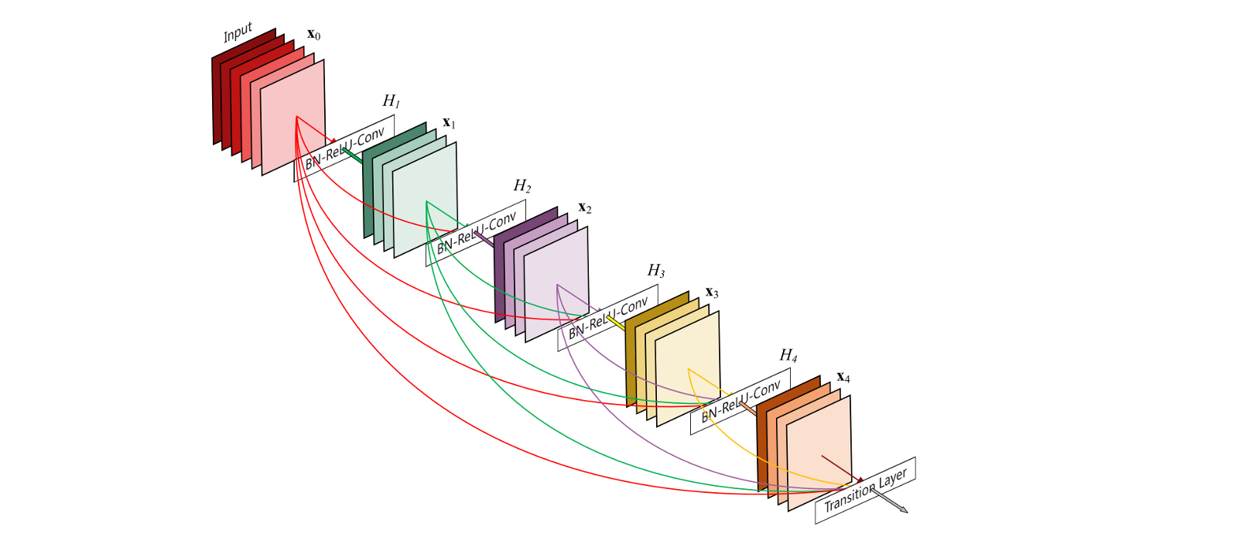
Evolution of CNN architecture:
DenseNet:

Slide 17
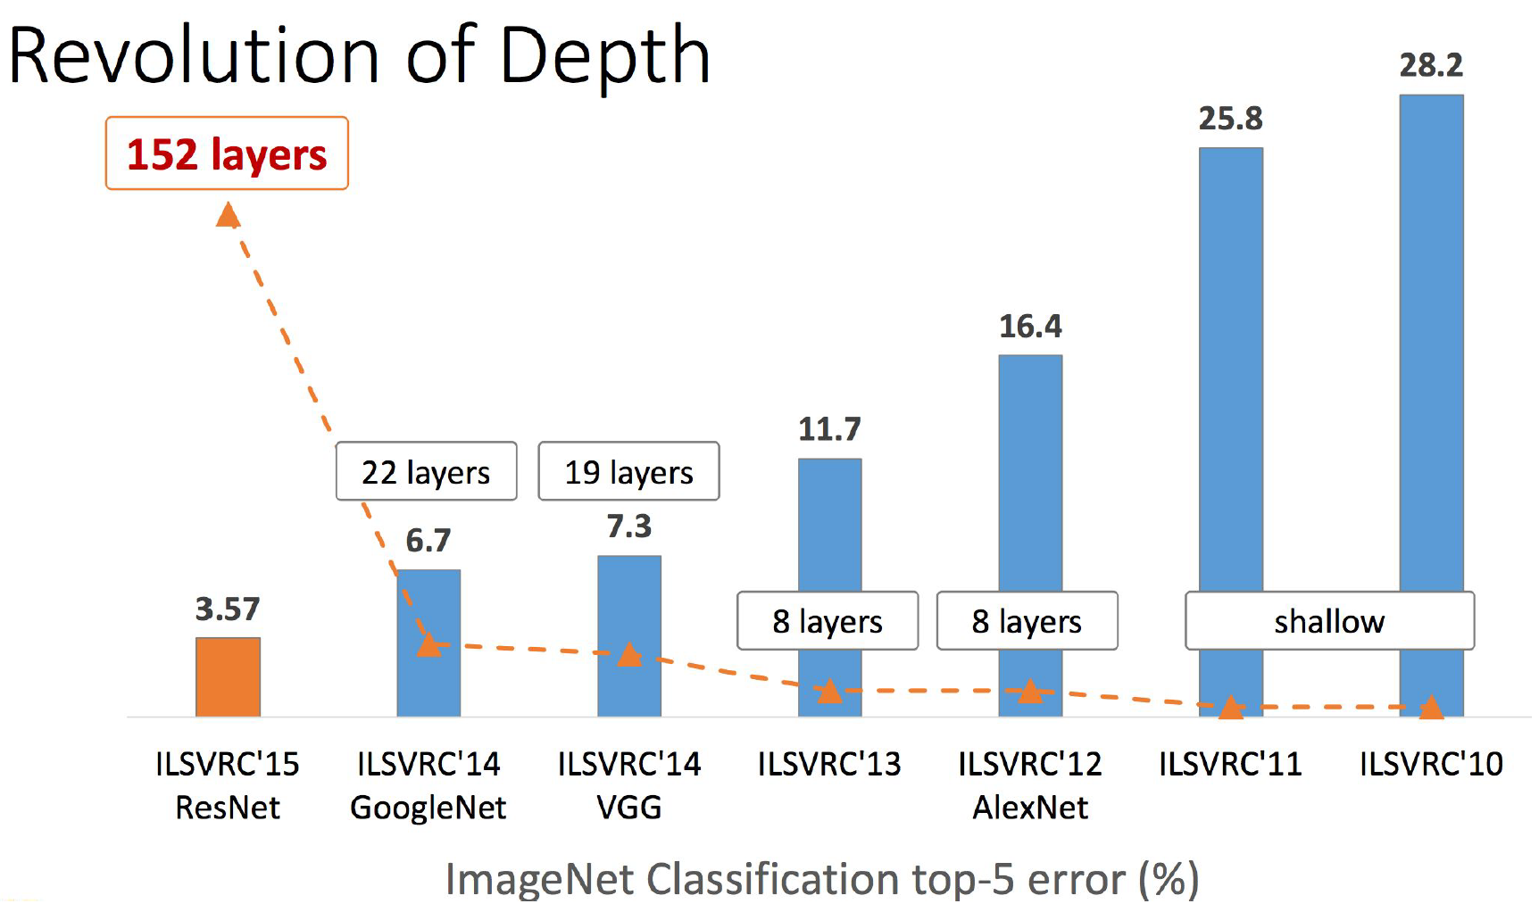
Evolution of CNN architecture:

Slide 18
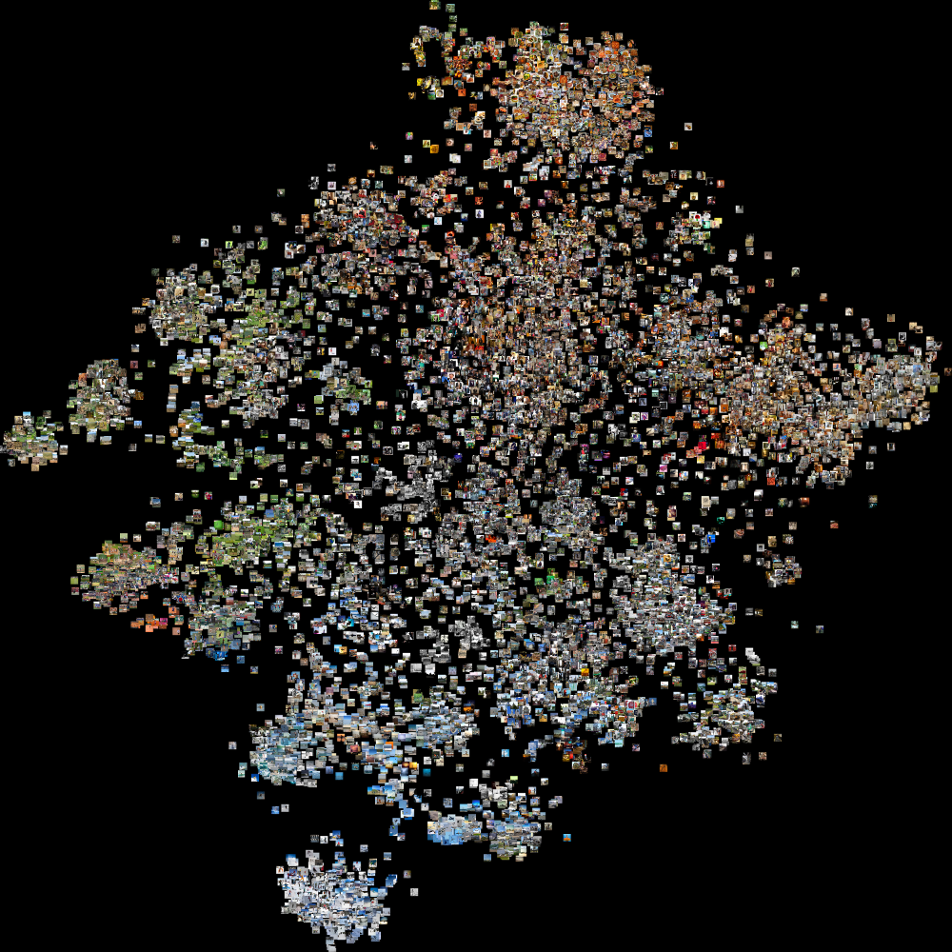
Using learned features embeddings

Slide 19
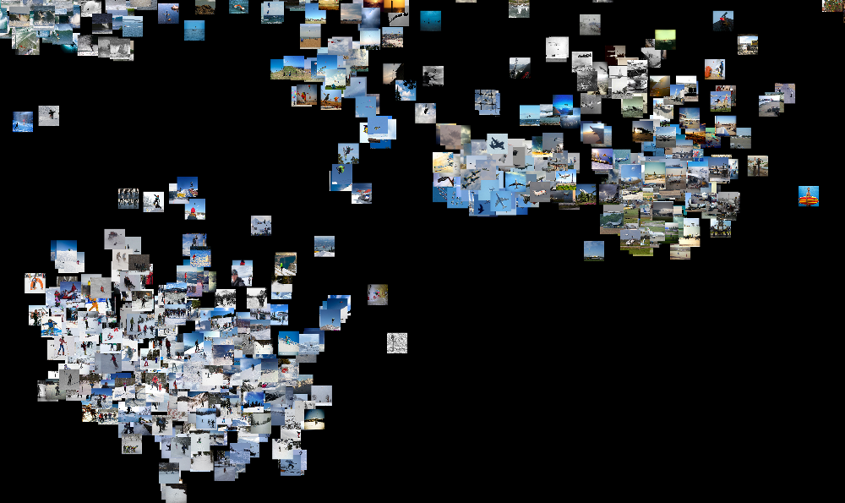
Using learned features embeddings

Slide 20
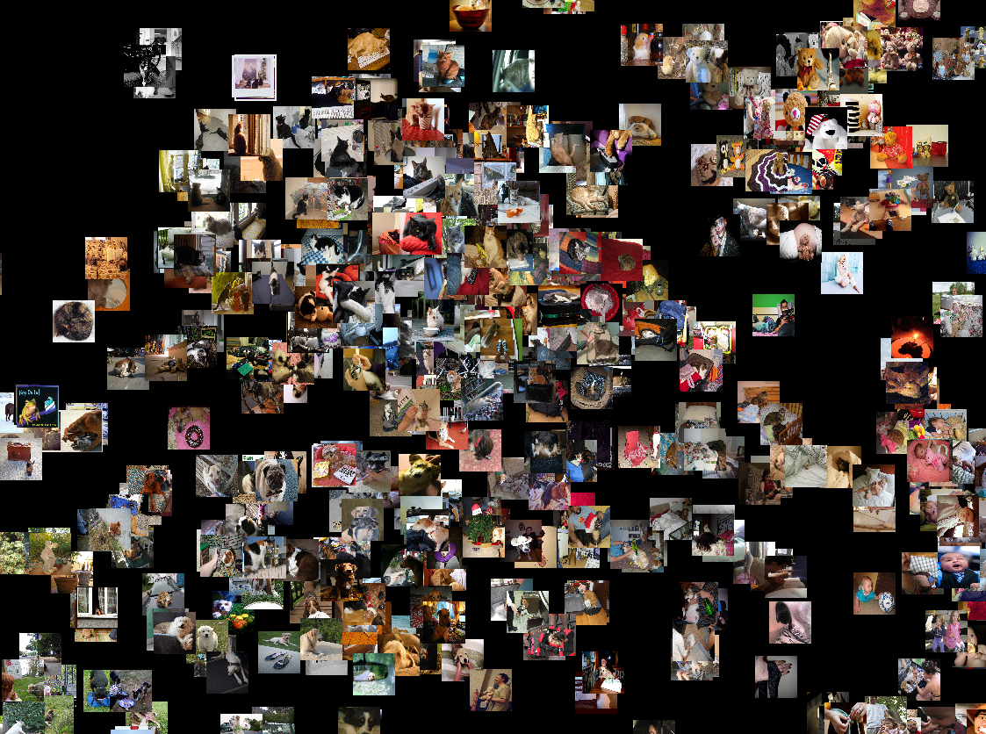
Using learned features embeddings

